Slide 1
ITNW 1335 Cloud Computing
Chapter 10 – Cloud Security Mechanisms

Slide 2
10.1. Encryption
Readable data is called plaintext and is vulnerable to unauthorized and malicious access when transmitted over a network.
The encryption mechanism is a digital coding system dedicated to preserving the confidentiality and integrity of data
The cipher transforms plaintext into ciphertext.
Access to ciphertext does not divulge the original plaintext data
When encryption is applied to plaintext data, the data is paired with a string of characters called an encryption key, a secret message that is established by and shared among authorized parties
The encryption key is used to decrypt the ciphertext back into its original plaintext format
Notes:
Figure:

Slide 3
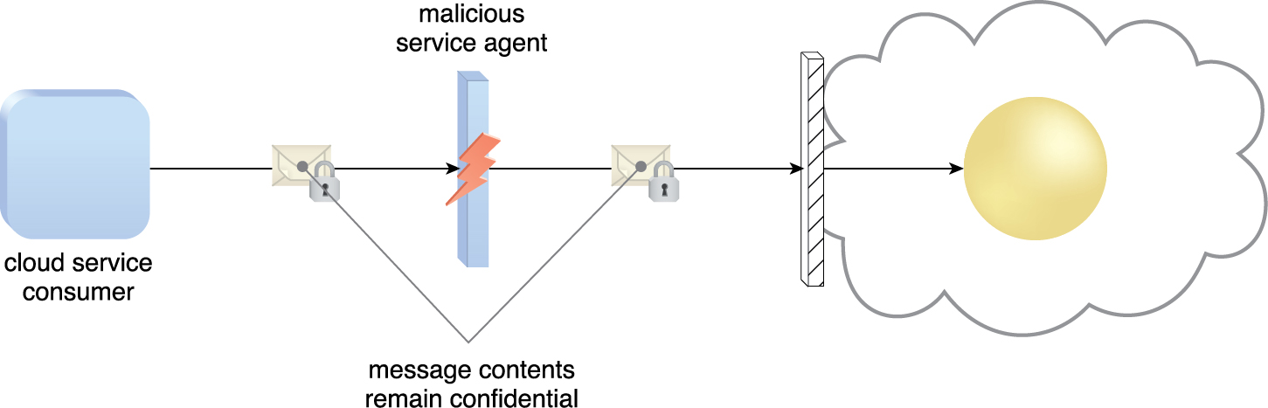
10.1. Encryption
The encryption mechanism can help counter the traffic eavesdropping, malicious intermediary, insufficient authorization, and overlapping trust boundaries security threats
Figure 10.1 A malicious service agent is unable to retrieve data from an encrypted message. The retrieval attempt may furthermore be revealed to the cloud service consumer. (Note the use of the lock symbol to indicate that a security mechanism has been applied to the message contents.)
Notes:
Figure:

Slide 4
10.1. Encryption
Symmetric Encryption
uses the same key for both encryption and decryption
Key is shared (also called secret key)
Parties that rightfully decrypt the data are provided with evidence that the original encryption was performed by parties that rightfully possess the key
Protect confidentiality
does not have the characteristic of non-repudiation

Slide 5
10.1. Encryption
Asymmetric Encryption
relies on the use of two different keys, namely a private key and a public key
the private key is known only to its owner while the public key is commonly available
One key is used to encrypt, the other is used to decrypt
almost always computationally slower than symmetric encryption
Confidentiality is protected when plaintext is encrypted with public key
Integrity, authentication and non-repudiation is protected when plaintext is encrypted with private key

Slide 6
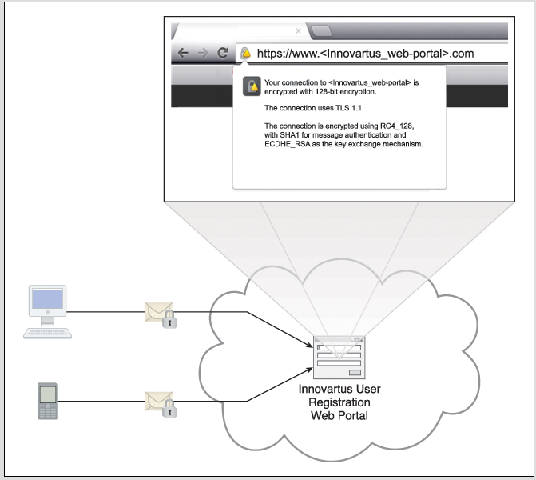
10.1. Encryption
Innovartus has recently learned that users who access their User Registration Portal via public Wi-Fi hot zones and unsecured LANs may be transmitting personal user profile details via plaintext. Innovartus immediately remedies this vulnerability by applying the encryption mechanism to its Web portal via the use of HTTPS
Figure 10.2 The encryption mechanism is added to the communication channel between outside users and Innovartus’ User Registration Portal. This safeguards message confidentiality via the use of HTTPS.
Notes:
Figure:

Slide 7
10.2. Hashing
The hashing mechanism
is used when a one-way, non-reversible form of data protection is required
Once hashing has been applied to a message, it is locked and no key is provided for the message to be unlocked
A common application of this mechanism is the storage of passwords
Produces a message digest that has a fixed length
Two different messages should not have identical message digests
The message digest cannot be reverse engineered
Notes:
Figure:

Slide 8
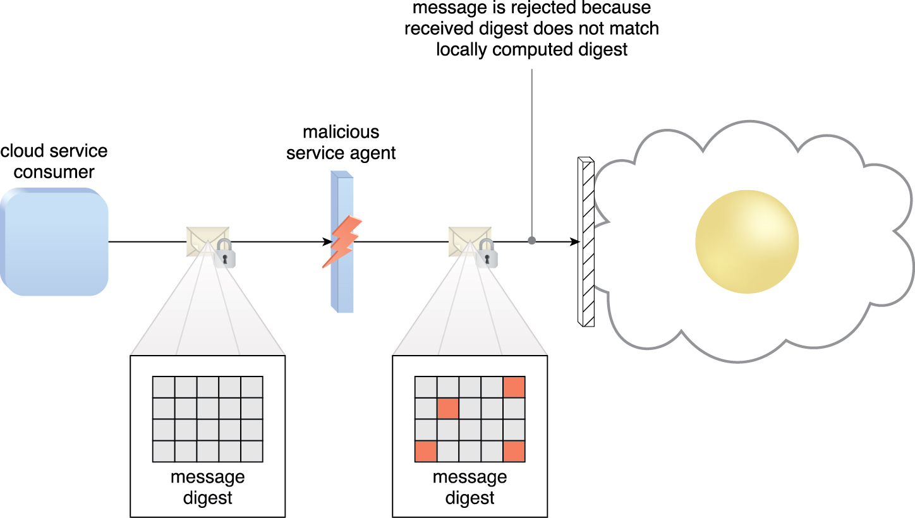
10.2. Hashing
A hashing function is applied to protect the integrity of a message that is intercepted and altered by a malicious service agent, before it is forwarded. The firewall can be configured to determine that the message has been altered, thereby enabling it to reject the message before it can proceed to the cloud service.
Figure 10.3
Notes:
Figure:

Slide 9
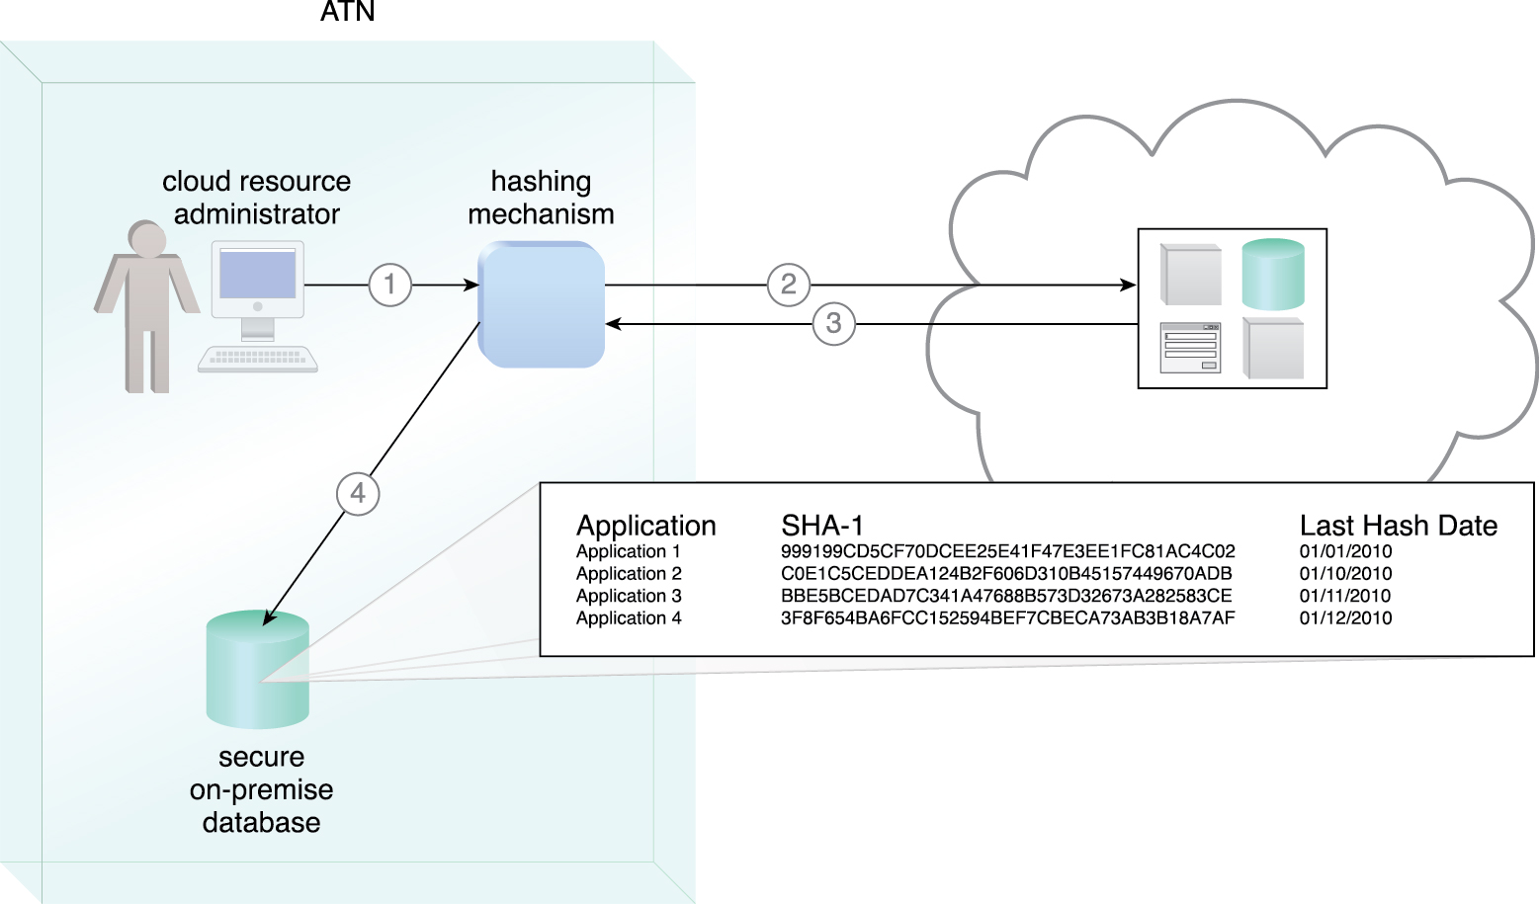
Case Study Example
A hashing procedure is invoked when the PaaS environment is accessed (1)
The applications that were ported to this environment are checked (2)
and their message digests are calculated (3)
The message digests are stored in a secure on-premise database (4)
and a notification is issued if any of their values are not identical to the ones in storage.
Figure 10.4
Notes:
Figure:

Slide 10
10.3. Digital Signature
The digital signature mechanism is a means of providing data authenticity and integrity through authentication and non-repudiation
A message is assigned a digital signature prior to transmission, which is then rendered invalid if the message experiences any subsequent, unauthorized modifications
A digital signature provides evidence that the message received is the same as the one created by its rightful sender
Both hashing and asymmetrical encryption are involved in the creation of a digital signature, which essentially exists as a message digest that was encrypted by a private key and appended to the original message
The recipient verifies the signature validity and uses the corresponding public key to decrypt the digital signature, which produces the message digest
The digital signature mechanism helps mitigate the malicious intermediary, insufficient authorization, and overlapping trust boundaries security threats
Notes:
Figure:

Slide 11
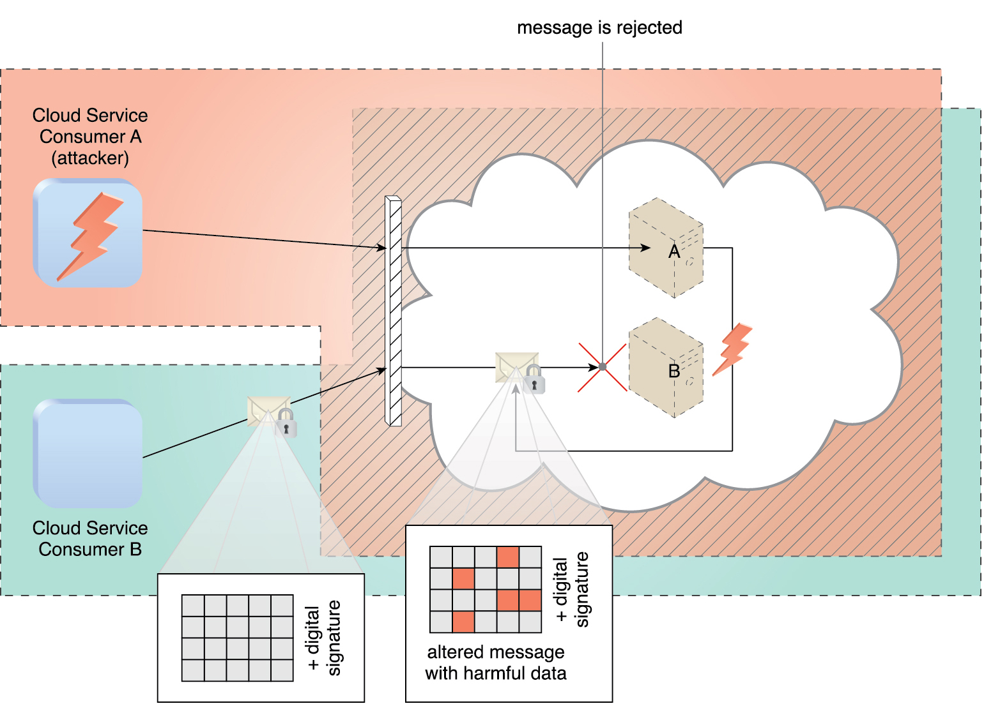
10.3. Digital Signature
Cloud Service Consumer B sends a message that was digitally signed but was altered by trusted attacker Cloud Service Consumer A
Virtual Server B is configured to verify digital signatures before processing incoming messages even if they are within its trust boundary
The message is revealed as illegitimate due to its invalid digital signature, and is therefore rejected by Virtual Server B.
Figure 10.5
Notes:
Figure:

Slide 12
10.4. Public Key Infrastructure (PKI)
The public key infrastructure (PKI) mechanism
Is a common approach for managing the issuance of asymmetric keys
exists as a system of protocols, data formats, rules, and practices that enable large-scale systems to securely use public key cryptography
used to associate public keys with their corresponding key owners (known as public key identification) while enabling the verification of key validity
rely on the use of digital certificates, which are digitally signed data structures that bind public keys to certificate owner identities, as well as to related information, such as validity periods
Digital certificates are usually digitally signed by a third-party certificate authority (CA)
Notes:
Figure:

Slide 13
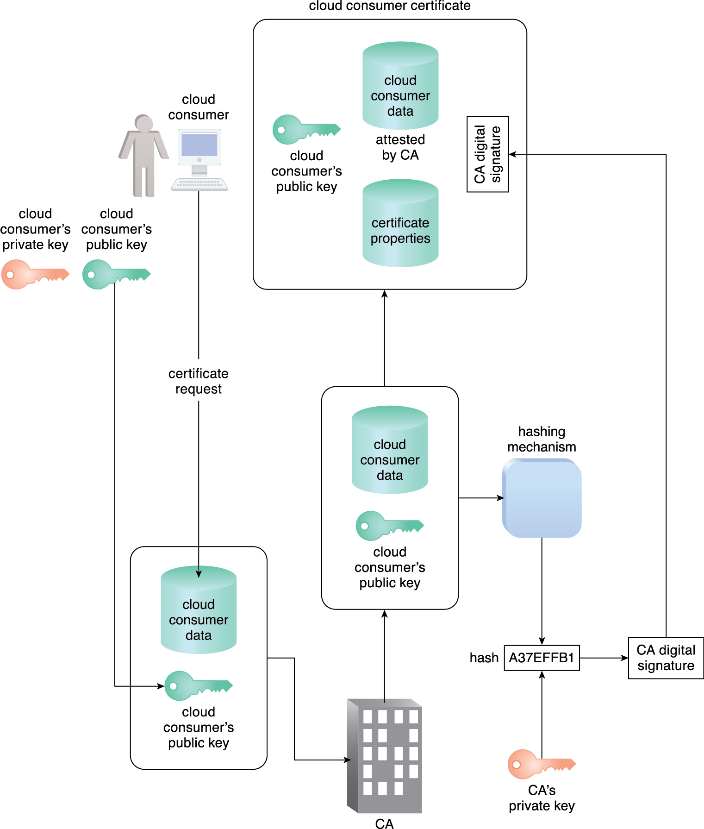
10.4. Public Key Infrastructure (PKI)
Figure 10.7 The common steps involved during the generation of certificates by a certificate authority.
Notes:
Figure:

Slide 14
10.4. Public Key Infrastructure (PKI)
Other methods can be used to create digital certificate
Most are generated by a trusted CA like Verisign, Comodo, Go Daddy
Large companies can create their own CA and self-sign their certificates
Building up an acceptable level of trust for a CA is time-intensive
Rigorous security measures, substantial infrastructure investments, and stringent operational processes all contribute to establishing the credibility of a CA
The higher its level of trust and reliability, the more esteemed and reputable its certificates
The PKI is a dependable method for implementing asymmetric encryption, managing cloud consumer and cloud provider identity information, and helping to defend against the malicious intermediary and insufficient authorization threats
Notes:
Figure:

Slide 15
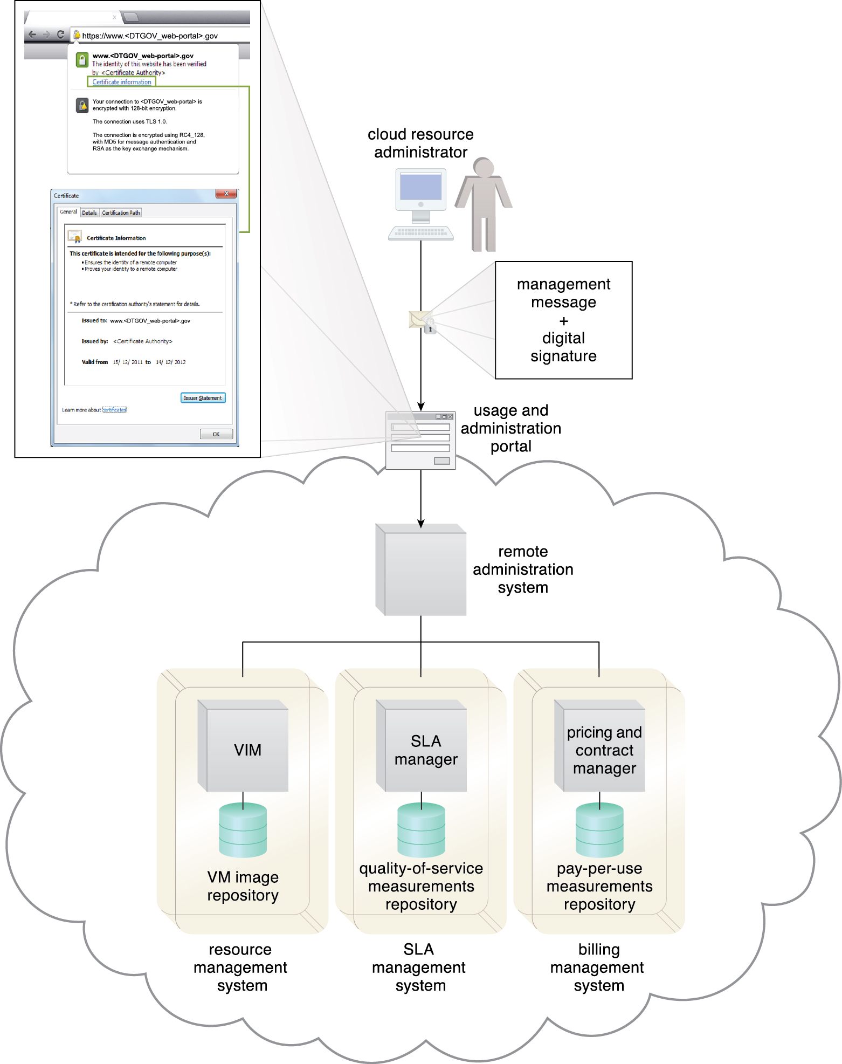
Case Study Example
An external cloud resource administrator uses a digital certificate to access the Web-based management environment. DTGOV’s digital certificate is used in the HTTPS connection and then signed by a trusted CA.
Figure 10.8
Notes:
Figure:

Slide 16
10.5. Identity and Access Management (IAM)
The identity and access management (IAM) mechanism encompasses the components and policies necessary to control and track user identities and access privileges for IT resources, environments, and systems
With similar objective as PKI, the IAM mechanism’s scope of implementation is distinct because its structure encompasses access controls and policies in addition to assigning specific levels of user privileges.
The IAM mechanism is primarily used to counter the insufficient authorization, denial of service, overlapping trust boundaries threats, virtualization attack and containerization attack threats

Slide 17
10.5. Identity and Access Management (IAM)
Components of IAM mechanism
Authentication – Username and password combinations but also can support digital signatures, digital certificates, biometric hardware (fingerprint readers), specialized software (such as voice analysis programs), and locking user accounts to registered IP or MAC addresses.
Authorization – The authorization component defines the correct granularity for access controls and oversees the relationships between identities, access control rights, and IT resource availability.
User Management – Related to the administrative capabilities of the system, the user management program is responsible for creating new user identities and access groups, resetting passwords, defining password policies, and managing privileges.
Credential Management – The credential management system establishes identities and access control rules for defined user accounts, which mitigates the threat of insufficient authorization.

Slide 18
10.6. Single Sign-On (SSO)
The single sign-on (SSO) mechanism enables one cloud service consumer to be authenticated by a security broker, which establishes a security context that is persisted while the cloud service consumer accesses other cloud services or cloud-based IT resources
Otherwise, the cloud service consumer would need to re-authenticate itself with every subsequent request
The SSO mechanism essentially enables mutually independent cloud services and IT resources to generate and circulate runtime authentication and authorization credentials.

Slide 19
10.6. Single Sign-On (SSO)
The credentials initially provided by the cloud service consumer remain valid for the duration of a session, while its security context information is shared
The SSO mechanism’s security broker is especially useful when a cloud service consumer needs to access cloud services residing on different clouds
This mechanism does not directly counter any of the cloud security threats
Traffic eavesdropping, DoS, insufficient authorization, malicious insider, etc
It primarily enhances the usability of cloud-based environments for access and management of distributed IT resources and solutions.

Slide 20
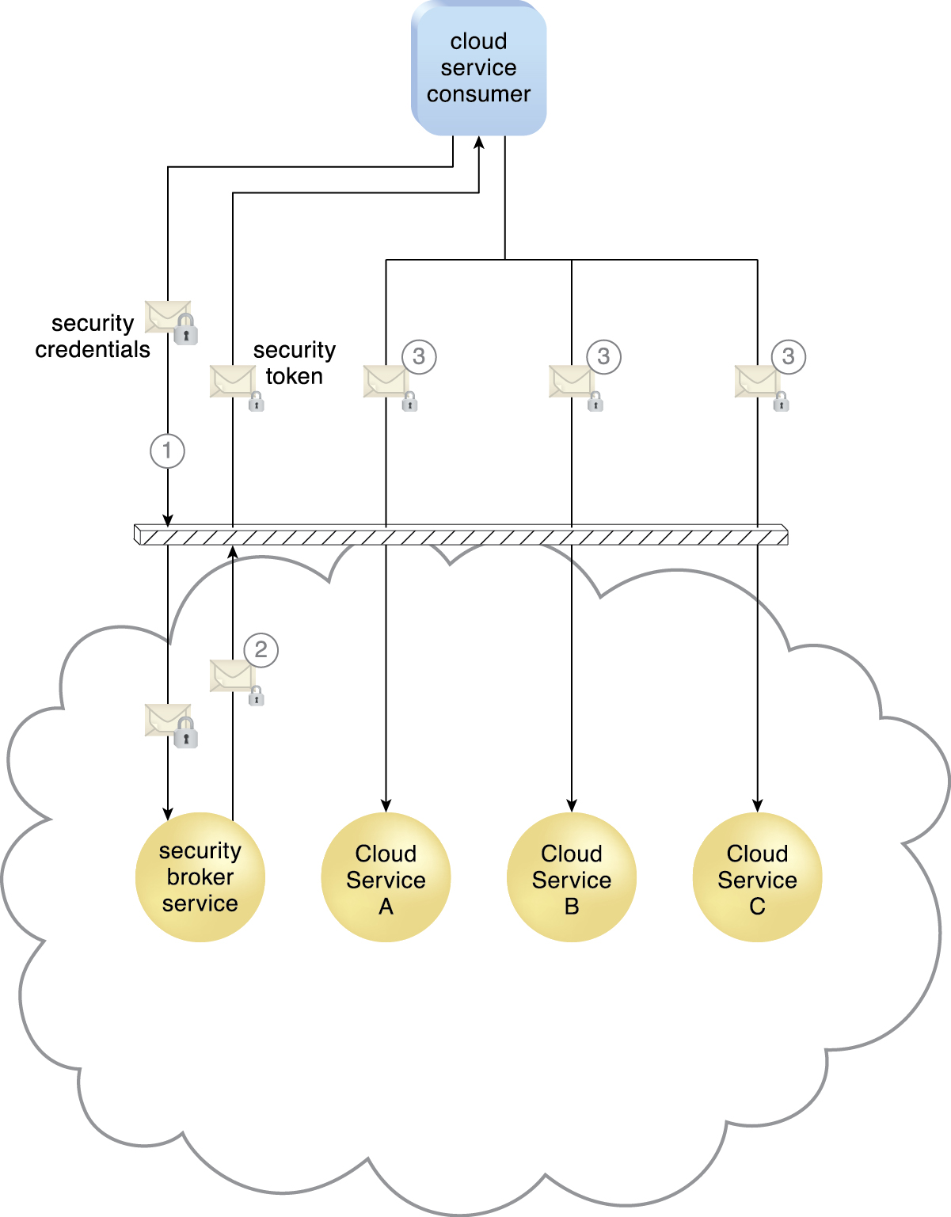
10.6. Single Sign-On (SSO)
Figure 10.8 An external cloud resource administrator uses a digital certificate to access the Web- based management environment. DTGOV’s digital certificate is used in the HTTPS connection and then signed by a trusted CA.
Notes:
Figure:

Slide 21
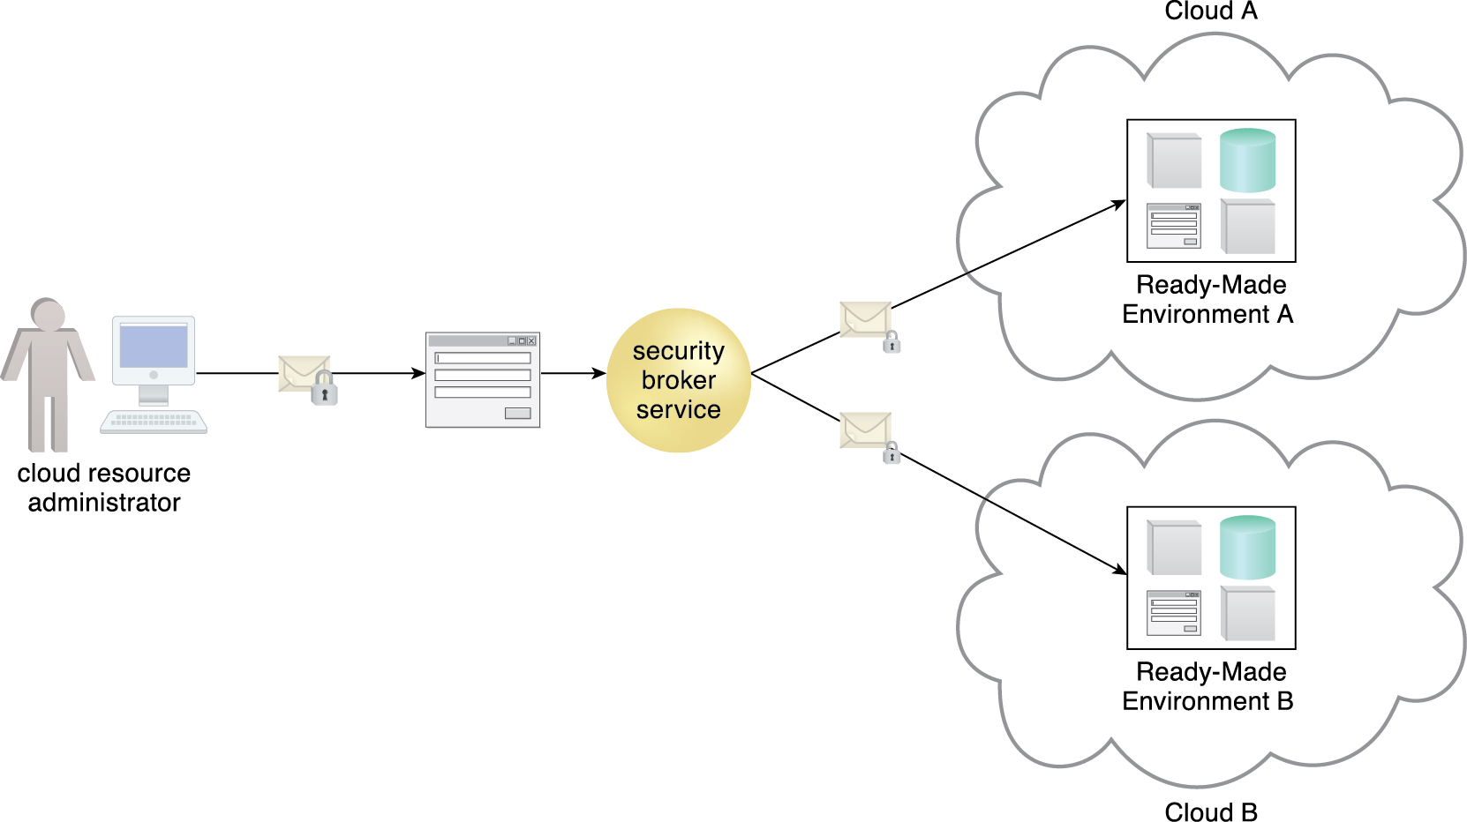
10.6. Single Sign-On (SSO)
Figure 10.10 The credentials received by the security broker are propagated to ready-made environments across two different clouds. The security broker is responsible for selecting the appropriate security procedure with which to contact each cloud.
Notes:
Figure:

Slide 22
10.7. Cloud-Based Security Groups
Cloud resource segmentation is a process by which separate physical and virtual IT environments are created for different users and groups
Resource segmentation is used to enable virtualization by allocating a variety of physical IT resources to virtual machines.
The cloud-based resource segmentation process creates cloud-based security group mechanisms that are determined through security policies
Each cloud-based IT resource is assigned to at least one logical cloud-based security group.
Each logical cloud-based security group is assigned specific rules that govern the communication between the security groups.

Slide 23
10.7. Cloud-Based Security Groups
Cloud-based security groups delineate areas where different security measures can be applied.
Properly implemented cloud-based security groups help limit unauthorized access to IT resources in the event of a security breach
This mechanism can be used to help counter the denial of service, insufficient authorization, overlapping trust boundaries, virtualization attack and container attack threats, and is closely related to the logical network perimeter mechanism

Slide 24
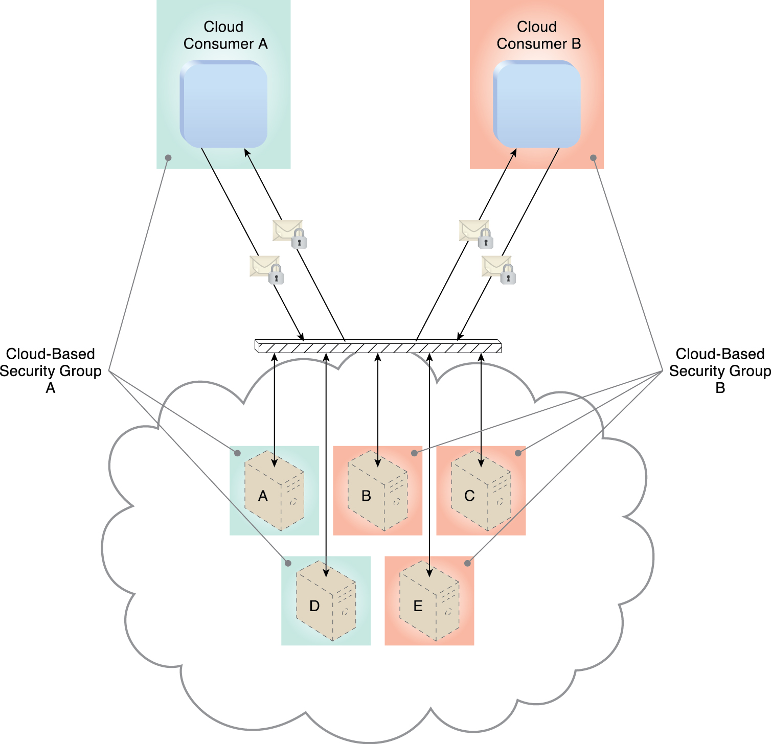
10.7. Cloud-Based Security Groups
Figure 10.11 Cloud-Based Security Group A encompasses Virtual Servers A and D and is assigned to Cloud Consumer A. Cloud-Based Security Group B is comprised of Virtual Servers B, C, and E and is assigned to Cloud Consumer B. If Cloud Service Consumer A’s credentials are compromised, the attacker would only be able to access and damage the virtual servers in Cloud-Based Security Group A, thereby protecting Virtual Servers B, C, and E.
Notes:
Figure:

Slide 25
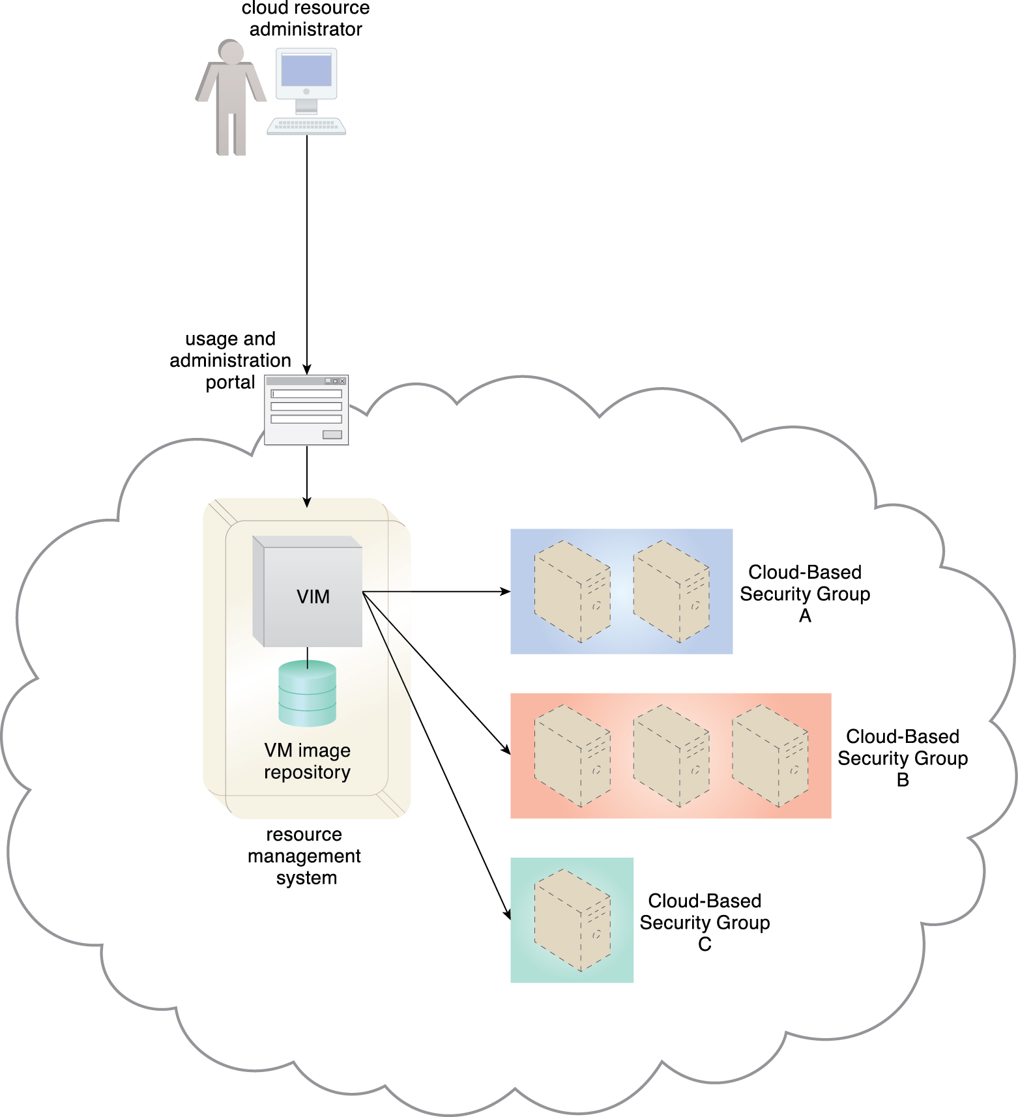
Case Study Example
Figure 10.12 When an external cloud resource administrator accesses the Web portal to allocate a virtual server, the requested security credentials are assessed and mapped to an internal security policy that assigns a corresponding cloud-based security group to the new virtual server.
Notes:
Figure:

Slide 26
10.8. Hardened Virtual Server Images
A virtual server is created from a template configuration called a virtual server image (or virtual machine image)
Hardening is the process of stripping unnecessary software from a system to limit potential vulnerabilities that can be exploited by attackers
Removing redundant programs, closing unnecessary server ports, and disabling unused services, internal root accounts
A hardened virtual server image is a template for virtual service instance creation that has been subjected to a hardening process
Hardened virtual server images help counter the denial of service, insufficient authorization, and overlapping trust boundaries threats.

Slide 27
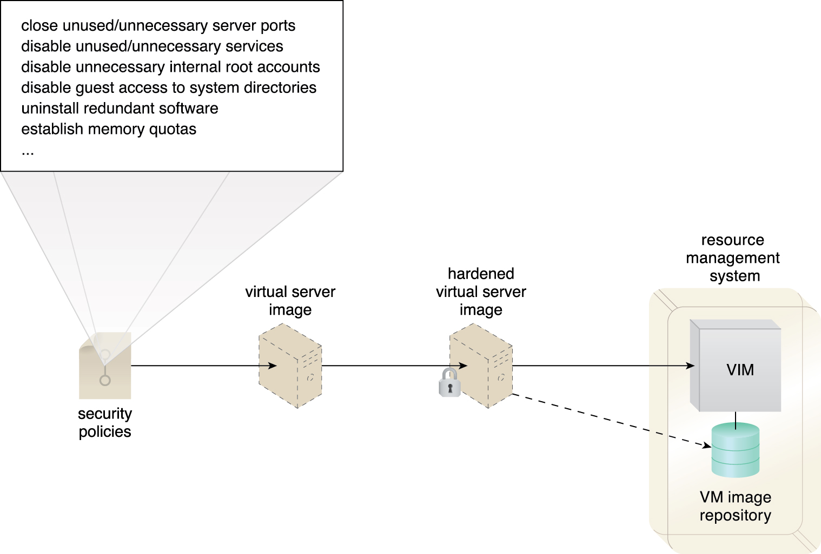
10.8. Hardened Virtual Server Images
Figure 10.13 A cloud provider applies its security policies to harden its standard virtual server images. The hardened image template is saved in the VM images repository as part of a resource management system.
Notes:
Figure:

Slide 28
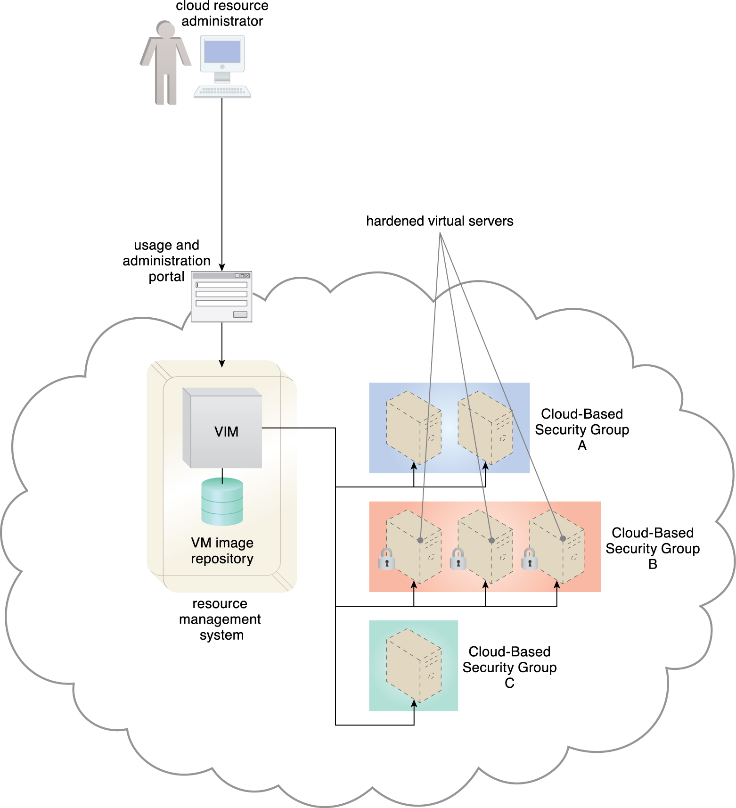
Case Study Example
Figure 10.14 The cloud resource administrator chooses the hardened virtual server image option for the virtual servers provisioned for Cloud-Based Security Group B.
Notes:
Figure:

